Slide 1

MACHINE LEARNING PROJECTS CLASSIFICATION & REGRESSION

Slide 2

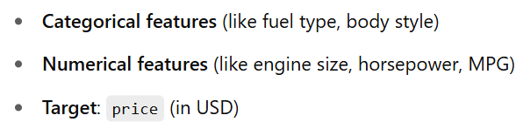

Car Price Prediction Using Regression
INTRODUCTION:
This project focuses on building a machine learning model to predict the price of a car based on various attributes like engine size, horsepower, brand, and fuel efficiency.
Goal: Predict car prices using machine learning Method: Linear Regression Dataset: 205 cars with 26 features.
Features
Load The Dataset

Slide 3

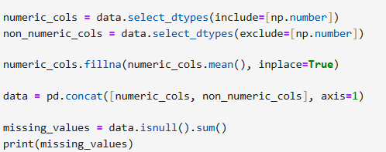

Data Preprocessing Steps
Import & Read Data
Purpose:
Load the dataset into a DataFrame for analysis
Data Cleaning
Purpose:
Remove irrelevant columns and standardize brand names.
Handling Categorical Data
Purpose:
Convert text-based (categorical) features into numerical format for modeling.
Removing Duplicates
Purpose
It removes any duplicate records from the dataset.
Feature Selection:
Removed low-importance and highly correlated variables.

Slide 4
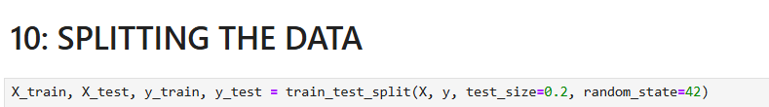

Modeling Using Linear Regression Model
Step 1: Train-test split (70/30)
70% for training, 30% for testing. This allows us to evaluate the model on unseen data.
Step 2: Feature Scaling
Feature scaling not required as regression coefficients handle scale internally
Step 3: Model Training
Model trained using sklearn.linear_model.LinearRegression

Slide 5
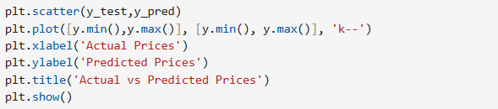
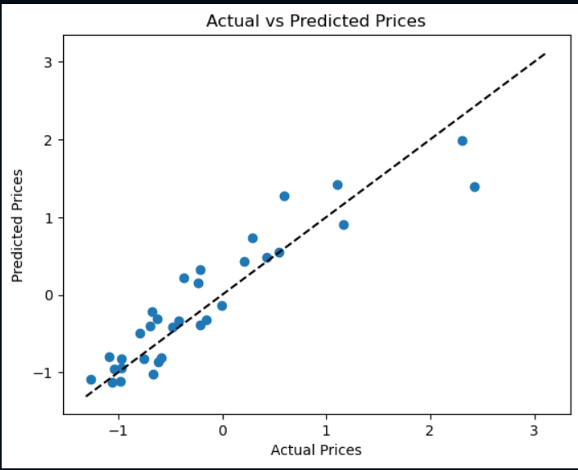
Prediction & Evaluation
Visualization: Residual plots and prediction vs actual plots used for model diagnostics.
Adds a label to the x-axis.
Adds a label to the y-axis.
Gives the plot a title, making it easier to interpret the chart.
Displays the plot on the screen plt.show()
Output
Plots a scatter plot of actual prices (y_test) vs predicted prices (y_pred).

Slide 6
Key Findings & Conclusion
Key Findings
Engine size, curb weight, and horsepower are the most influential predictors.
Cars with higher engine size and weight are more expensive.
Certain brands (like BMW, Audi) tend to have higher prices on average.
Linear regression performs well with selected features (R² ~ 0.86 on test set).
Conclusion
Data preprocessing in ensuring clean and useful inputs.
Feature selection in improving model performance.
Visualization in gaining insights and validating model results.
Good accuracy achieved with relatively simple preprocessing and feature selection.
Can be extended using advanced techniques (Ridge, Lasso, Random Forest) for potential performance gain.
Useful application in pricing strategy and recommendation engines for automotive platforms.

Slide 7



Introvert Vs Extrovert Behavior Using Classification
BASIC LIIBRARIES
Pandas is used for data manipulation and analysis.
INTRODUCTION
A supervised machine learning model that classifies individuals as Introvert or Extrovert based on social behavior indicators.
Overview:
Goal: Predict if a person is Introvert or Extrovert using behavior data.
Predict personality type (Extrovert/Introvert) using behavioral features.
Dataset: 2,900 rows, 8 features.
Application: Personality prediction, marketing, mental health analysis.
NumPy (Numerical Python) is used for numerical computations.
Seaborn is a statistical data visualization library built on top of matplotlib.
Matplotlib is the foundation of data visualization in Python.
FEATURES
Time_spent_Alone – hours spent alone daily.
Stage_fear – stage fright (Yes/No).
Social_event_attendance – how often they attend events.
Going_outside – days per week they go outside.
Drained_after_socializing – drained after interaction (Yes/No).
Friends_circle_size – number of close friends.
Post_frequency – social media posting rate.
Personality – Target: Introvert or Extrovert.
Load The Dataset

Slide 8






Data Preprocessing Steps
Exploring The Data
Checking & Removing Duplicates
Purpose:
Avoids bias or redundancy in training caused by repeated rows.
Identifies missing values in the dataset.
Provides a statistical summary of numerical columns.
Encoding Categorical Variables
Gives a quick overview of the dataset structure.
Purpose:
To convert categorical values into numerical.
Handling Missing Values
Purpose: To replace missing data with meaningful values.
Feature Separation
Purpose:
Separate input features (X) and target labels (y).

Slide 9
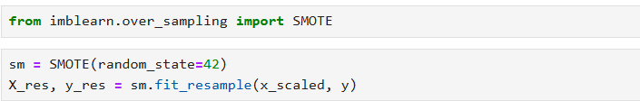
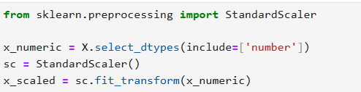
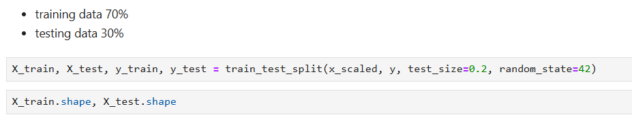
Scaling / Normalization
Purpose:
Scale all numerical features to a similar range to improve model training speed and performance.
Handling Imbalanced Data (SMOTE)
Purpose:
SMOTE (Synthetic Minority Over-sampling Technique) balances the dataset by creating synthetic examples of the minority class.
Correlation Matrix (Feature Selection Insight)
Purpose:
Understand which features are correlated — helps in feature selection or engineering.
Splitting into Training and Testing Data
Purpose:
Divide data into:
Training set 70% (used to learn patterns).
Testing set 30% (used to evaluate performance).

Slide 10

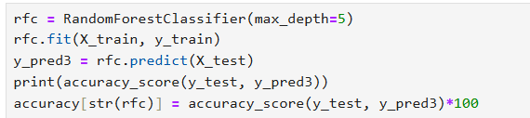
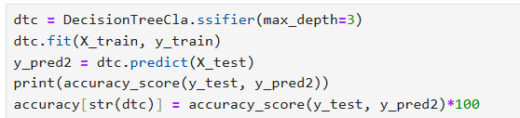
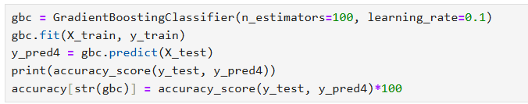
Modeling Using Classification
Logistic Regression
Random Forest Classifier
Purpose
Used for binary classification problems. It models the probability that an instance belongs to a particular class.
Purpose
An ensemble method using multiple decision trees. Reduces overfitting and improves generalization.
Decision Tree Classifier
Purpose
Splits data into tree-based rules for prediction.
Can overfit on small datasets but captures non-linearity.
Gradient Boosting Classifier
Purpose:
An advanced ensemble technique that builds trees sequentially, each correcting the error of the previous one.
Best model selected based on performance

Slide 11
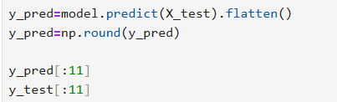

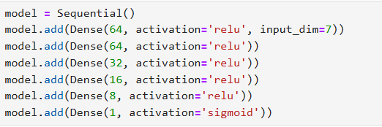
Model Evaluation & ANN
Deep Learning Model: Artificial Neural Network
Evaluation
Purpose:
Used for learning complex non-linear patterns. Great for high-dimensional data. This model uses 5 layers.
Accuracy Table (By Model)
Model Design:
nput Layer: Takes input features
Hidden Layers: 4 hidden layers using ReLU
Output Layer: 1 neuron, Sigmoid for binary classification (Introvert = 0, Extrovert = 1)
Model | Accuracy (%)
Logistic Regression | ~76%
Decision Tree | ~74%
Random Forest | ~79%
Gradient Boosting | ~78%
SVC | ~77%
ANN (Deep Learning) | ~80%

Slide 12

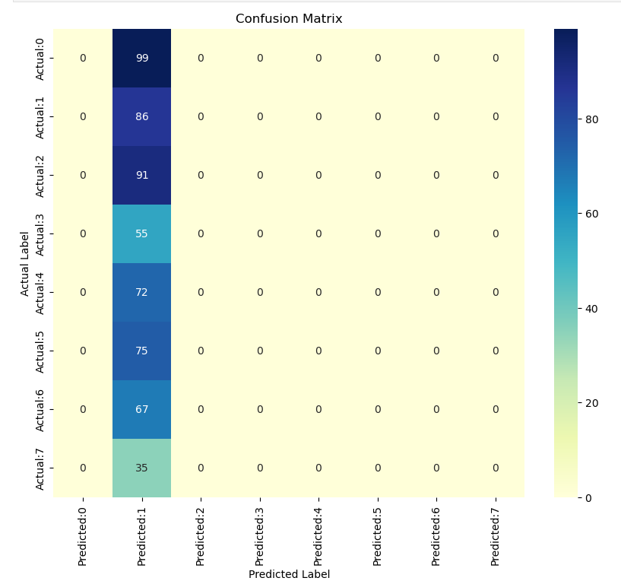
Confusion Matrix
Output
A confusion matrix helps visualize the performance of a classification model by comparing predicted labels with actual labels.

Slide 13
Key Findings & Conclusion
Key Findings
Conclusion
Data cleaning significantly improved accuracy.
Best R² Score achieved: (Insert score).
Linear Regression performed consistently; tree models gave better generalization.
Data Preprocessing: Cleaned the dataset and handled categorical variables. Ensured features were converted to numerical types for model compatibility.
Model Building: Created a Neural Network using Keras Sequential API. Architecture included input, hidden, and output layers with activation functions (relu, sigmoid).
Model Training: Trained the model with X_train and y_train using 100 epochs and batch size of 100. Used validation_split=0.2 to monitor validation performance.
Predictions & Evaluation: Made predictions on X_test. Evaluated performance using a confusion matrix and classification metrics.
Top Predictive Features:
Time_spent_Alone
Friends_circle_size
Social_event_attendance
Results
Model successfully learned the patterns in data. Confusion matrix shows reasonable accuracy with room for improvement in certain misclassified cases.

Slide 14

Thank you
Presented By: Amna Shahzad

